Slide 1
SMART CLASSROOM MONITORING ROBOT
Ramya.B
II MCA
211500803

Slide 2
ABSTRACT
This project proposes the design and implementation of a noise sensor with a buzzer to monitor and control the noise level in a classroom setting. The microcontroller will analyze the noise level in real-time and trigger a buzzer alarm if the sound level exceeds a predetermined threshold.
The buzzer will provide an audible alert to the students, indicating that they need to lower their voices. The proposed system is easy to implement, and the noise threshold can be adjusted according to the teacher's preference.
Another feature is to schedule classes and announce to students using speakers.

Slide 3
The system comprises a scheduling software and a speaker system.The software sends the announcements to the speaker system, which is programmed to broadcast the announcements at the scheduled times.
The system is highly customizable and can be adjusted according to the College requirements. The scheduling software can be set to generate announcements for specific classes, and the speaker system can be programmed to broadcast the announcements to the class.
In conclusion, the proposed system offers an efficient and effective way to manage the schedules and broadcast announcements to students. The system can help to minimize disruptions in the classroom and improve the overall learning environment for students.

Slide 4
EXISTING SYSTEM
We have event manager, where the events are programmed by teachers.
Teachers have to maintain their students by themselves, where there is a huge noise in the classroom.
Teachers who work in noisy classrooms may experience increased stress and fatigue.
There is recording based system,where we have to play a specific audio by CD-drive or pendrives.

Slide 5
PROPOSED SYSTEM
In this module we can fix a time for the schedule so that the students can make it on time.
We have a buzzer to alert the teachers to control the student noise level.
Teachers can easily detects the noise of a student and they can monitor them easily when the buzzer rings.
We have updated our project where we can program what has to be played and what specific audio needs to be played.

Slide 6
BLOCK DIAGRAM: ROBOT
Power Supply
Raspberry pi
Buzzer
Sound sensor
Speaker
Arduino Uno
Motor Driver

Slide 7
REQUIREMENTS
Hardware Requirements
Software Requirements
Raspberry Pi
Sound sensor
Buzzer
Arduino Uno
Motor
Raspian OS
Python Programming language.

Slide 8
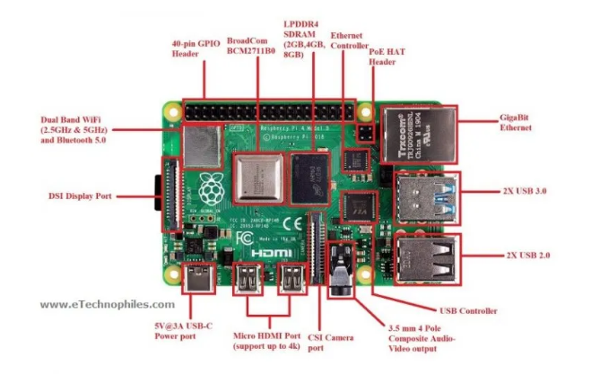
Raspberry Pi
Small form factor: Raspberry Pi is small in size and can easily be integrated into a robot.
High processing power: Raspberry Pi has a relatively high processing power for running complex algorithms and programs required for smart classroom monitoring robot.

Slide 9
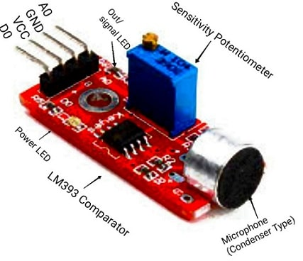
Sound Sensor
WORKING PRINCIPLE:
The working principle of this sensor is related to human ears. Because human eye includes a diaphragm and the main function of this diaphragm is, it uses the vibrations and changes into signals. Whereas in this sensor, it uses a microphone and the main function of this is, it uses the vibrations and changes into current otherwise voltage.

Slide 10
Modules
Audio Feature
Remainder Feature
Buzzer to alert the staff

Slide 11
Audio Feature
In this feature we have a recording system where we can play a short audio like college prayer song, with the help of “Raspian os”.
We can play college prayer song before the respective period starts.
We can also set the “time” for the audio to playback later.
The file path of the audio file is set to “MC.mp3”.

Slide 12
REMAINDER FEATURE
Ensures that students are aware of upcoming tests and have enough time to prepare, By sending a reminder in advance, students will be aware of the test and have enough time to review the instructions and prepare accordingly.
Reduces forgetfulness: Students are often busy with other activities and may forget about tests. The reminder feature helps reduce forgetfulness and ensures that students do not miss important tests.

Slide 13
To schedule an event for students regarding college instructions using Python code and Raspberry Pi, you can use the following steps:
1.First import the libraries such as “time” and “datetime” in python code.
2.Then, create a loop that checks the current time every minute and compares it to the event date and time.
3.Finally, include the instructions for the event within the event trigger.
4. Print the necessary event that we need to instruct the students.
For Example “You have your semester practical on Wednesday”

Slide 14
BUZZER TO ALERT THE STAFF
Buzzer is a device that emits a loud sound to notify staff members of an event or situation that requires their attention.
In order to use a buzzer to alert the staff when a student is speaking in the classroom, you would need to first identify the specific condition that will trigger the buzzer
One approach could be to use a sound level sensor to detect when the noise level in the classroom exceeds a certain threshold, which would indicate that a student is speaking.

Slide 15
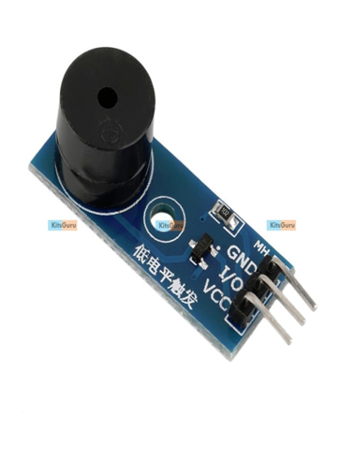
3.Continuously monitor the sound level in the classroom using a sound level sensor. If the sound level exceeds the threshold, turn on the buzzer.
4.Once the sound level goes back below the threshold, it will turn off the buzzer.
5. And we can also set a Voice through Speaker to alert the students not to talk in the classroom.
For example: "Please don't talk in the classroom"

Slide 16
FUTURE ENHANCEMENT
This project can be updated by a Wireless feature without any manual intervention.
Real-time monitoring of the noise levels in the library could help staff to identify patterns of noise and take action to reduce noise levels before they become disruptive. This could help to maintain a quieter and more productive learning environment.
We can add more events to our convenience in the future and Extend the time of playing by developing the code.
This can be implement in the exam Hall to monitor the students, Where we can prevent when the student caught from Malpractice.

Slide 17
CONCLUSION
In conclusion, a smart classroom monitoring robot can be a valuable tool in enhancing the learning environment for students. Incorporating features such as a noise sensor with a buzzer alarm can help promote a quieter learning environment and improve the overall classroom experience. Similarly, the recording feature can be used to play the audio for playback later. Overall, a smart classroom monitoring robot can help create a more efficient and engaging learning environment, providing benefits for both teachers and students.

Slide 18

THANK YOU

